Slide 1
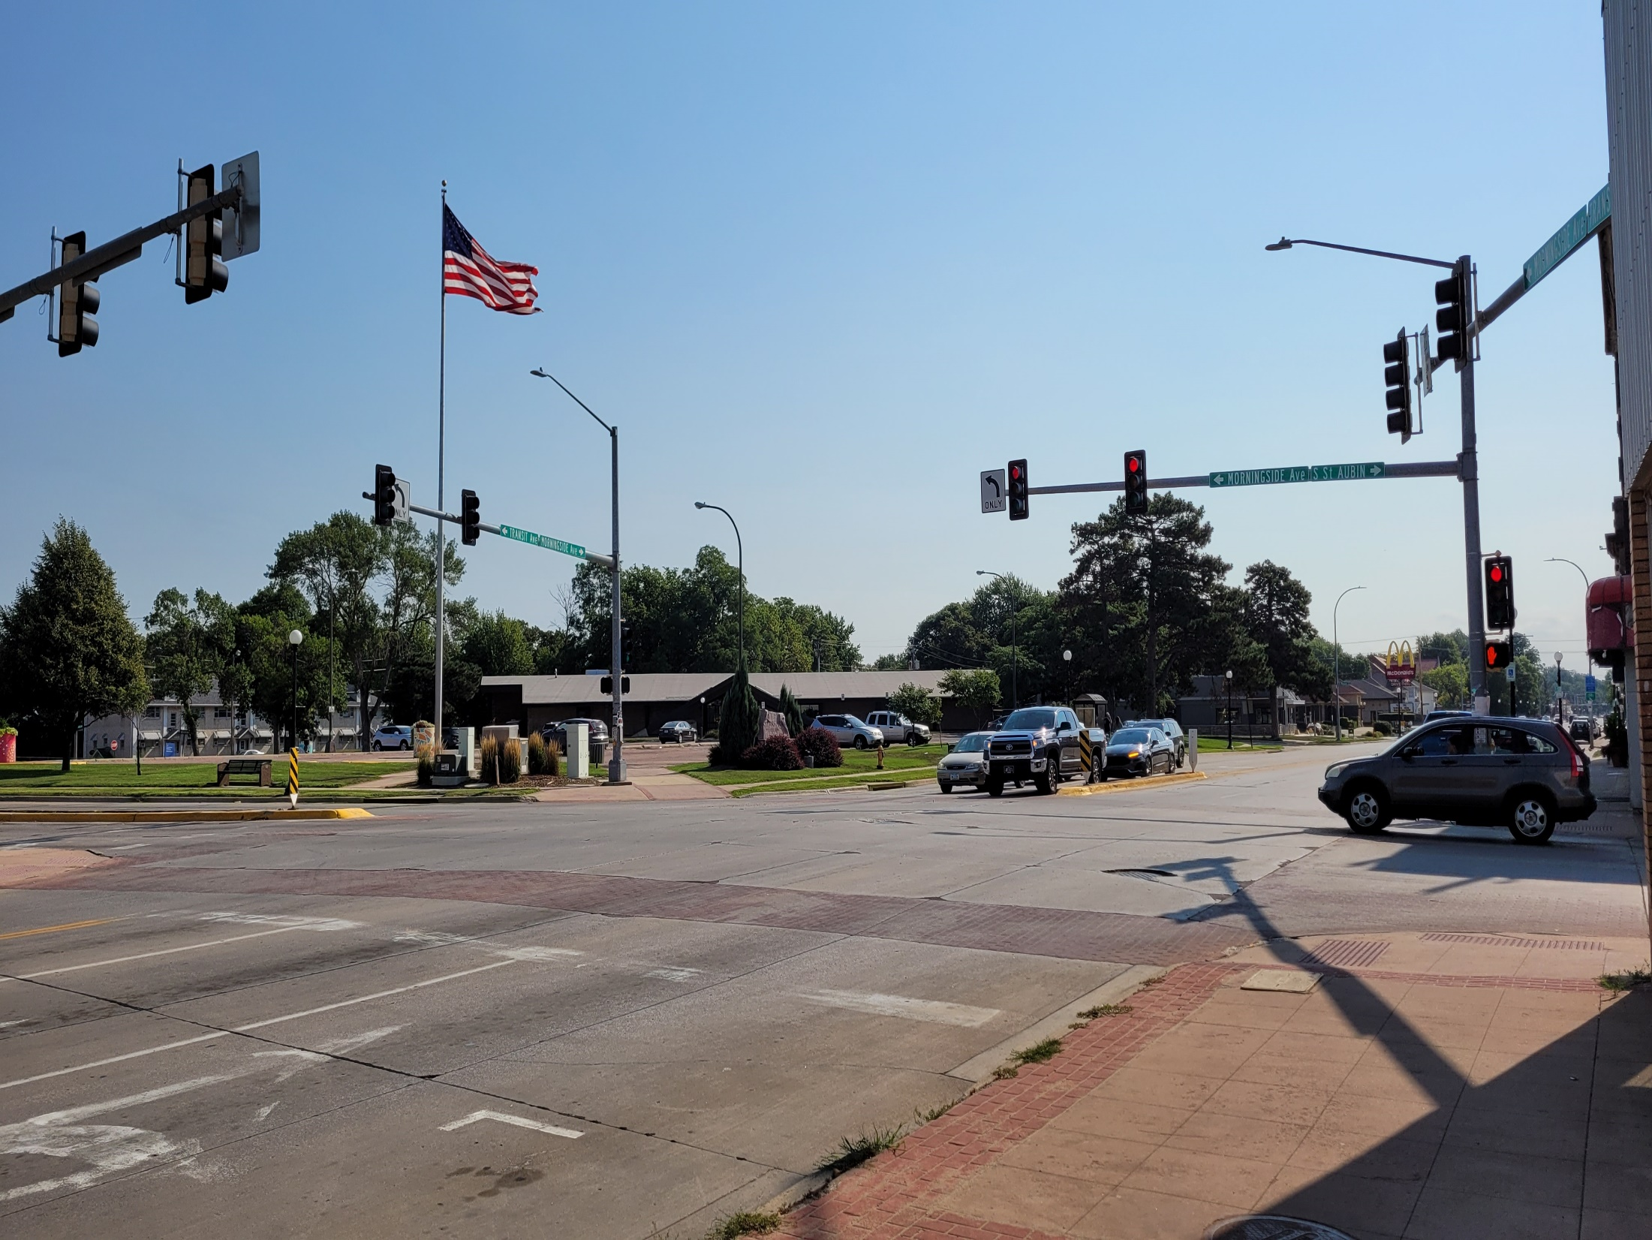
Peters Park Corridor Façade Improvement Program Kickoff Meeting
Tuesday August 17, 2021

Slide 2

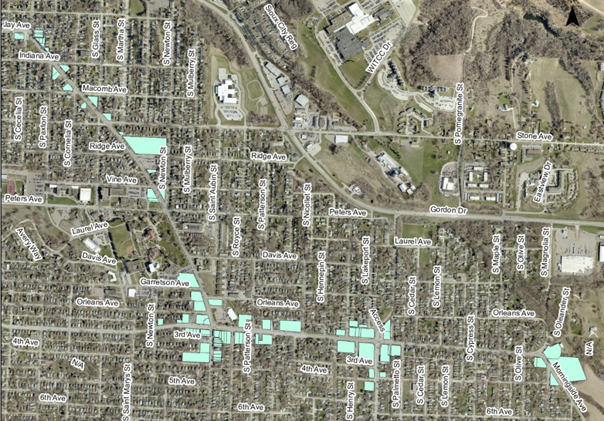
Peters Park Corridor Façade Improvement Program
88 Properties

Slide 3
Program Information
Forgivable Loan
$60,000 max award per property
Same owner can apply for separate properties
25% match required
Mortgage and Promissory Note required
If property sold within 5 years, funds required to be paid back
20% forgiven per year
Projects over $10,000 eligible for additional $2,000 in design work
Projects over $10,000 broken down into $10,000 increments
Staff may recommend approval of partial projects depending on funding availability
6 months to complete project

Slide 4
Eligible Improvements
Repair, restoration, or installation of exterior masonry and siding materials.
Repair, replacement, or installation of awnings, windows, trim, doors, gutters, down-spouts, stone and brick, or other architectural details.
Repair, replacement, or installation of exterior lighting attached to a building or illuminating a sign.
Repair or construction of entryways.
Cleaning, preparation, and painting exterior walls and trim in an appropriate color palette.

Slide 5
Eligible Improvements
Removal of barriers to access for people with disabilities.
Removal, replacement, or repair of exterior wall or projecting signs.
Screening and landscaping of surface parking facilities and outdoor areas.
Public art and murals.
Other improvements as approved.

Slide 6
Application
Hardcopies at meeting
Available Online
Available in City Hall – Planning Department

Slide 7
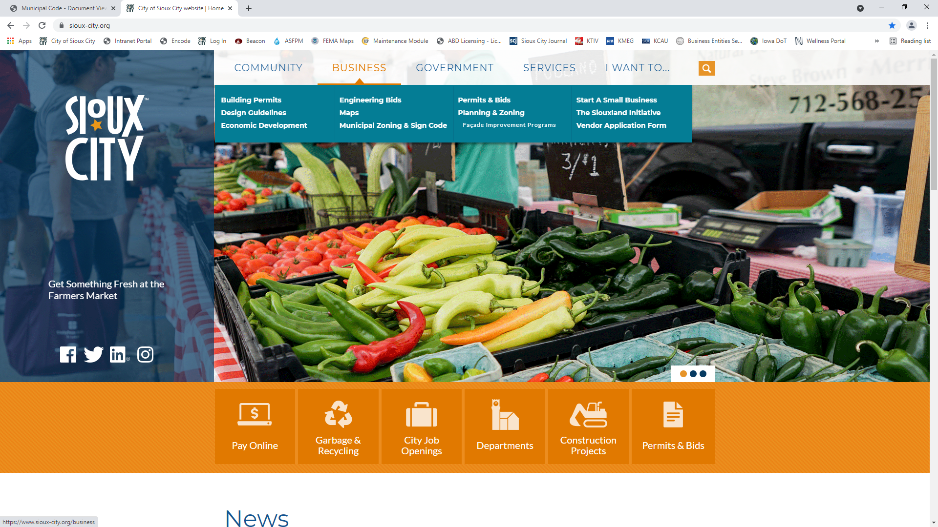
Application
www.sioux-city.org

Slide 8
Application

Slide 9
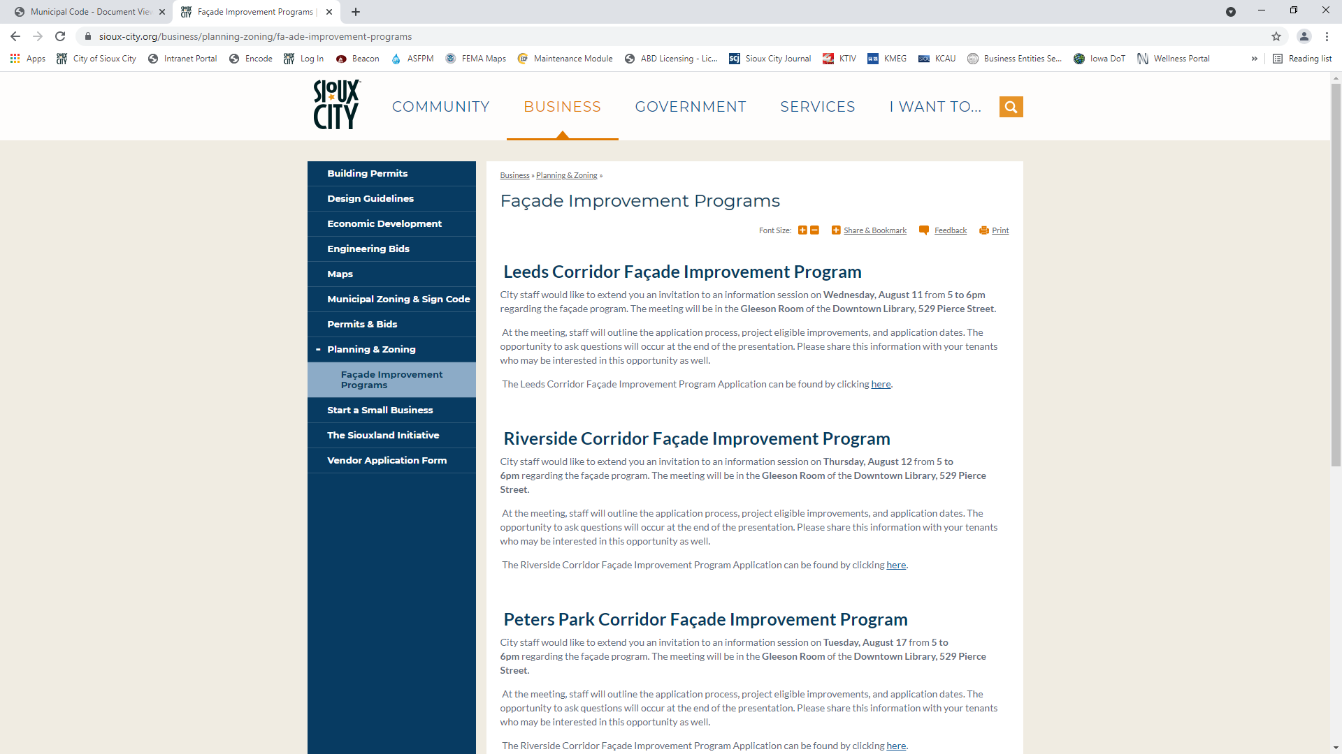
Application

Slide 10
Process
City Council Approves Program
City Staff notify property owners of program
Preliminary Meeting with City Staff
Submittal of Application
Deadline: October 1, 2021
Staff Review / Scoring
City Council Approval
Applicant signs letter of award
Mortgage and promissory note
Applicant secures bid and contracts with bidder
City reimburses the applicant within 30 days of project completion

Slide 11
Scoring
Property visibility
Importance to the Area
Significance of Property
Existing Condition / Potential for Improvement
Impact of Improvement
Development in the area

Slide 12
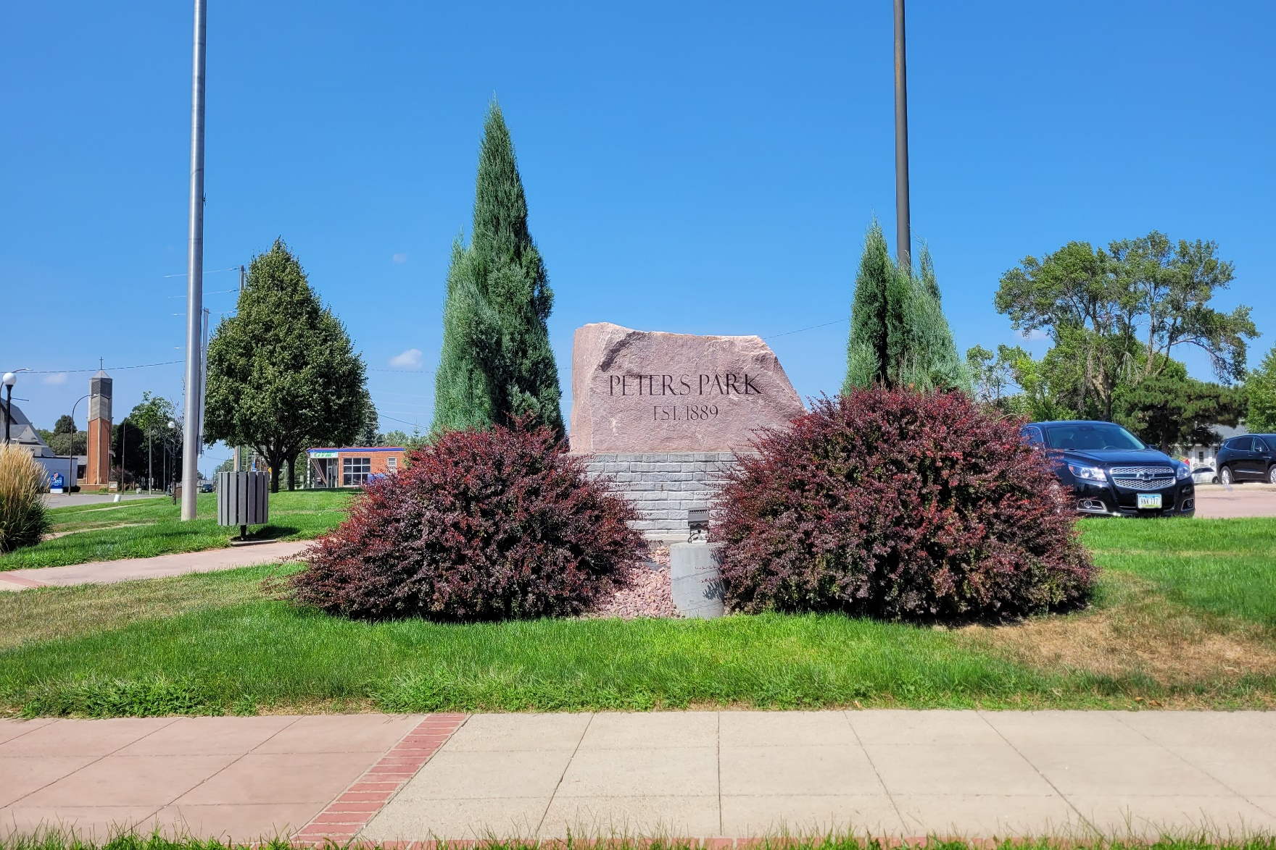
Questions?

